Slide 1
www.rocpab.org

Slide 2
2023 Agenda Review
Completed Projects
Project | Type | Date of Board Vote
Data Transparency | Proposal for Change | 5/18/2023
Right to Know | Proposal for Change | 10/5/2023 and 11/9/2023
Juvenile Use of Force | Oversight Investigation | 2/1/2024
Protest Policies | Proposal for Change | 5/22/2024
CBA - Discipline | Oversight Investigation | 6/6/2024
Cost of Misconduct | Proposal for Change | 12/5/2024

Slide 3
2025 Policy Agenda
New Projects
Vehicular Pursuits
Sexual Assault Investigations
Applications of Artificial Intelligence
CBA: Arbitration
CBA: Overtime
Law Enforcement Mutual Aid Agreements
Language Access at the RPD
Intimate partner violence
Equitable Policing

Slide 4
Vehicular Pursuits
Project Justification
Background
There have been several police pursuits in Rochester that resulted in multiple arrests and fatalities directly impacting the community.
Proposal
Proposal for change to recommend policy changes to the current G.O. 530.
Plan
Compare past and current RPD pursuit policies with national best practices.
Provide recommendations to contribute to a more transparent and effective pursuit policy framework for the RPD.

Slide 5
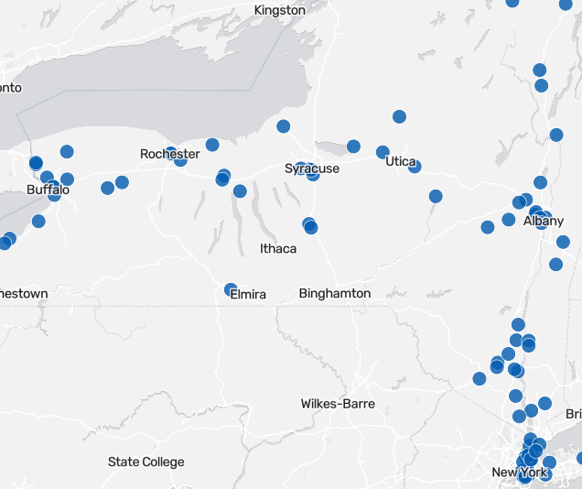
Vehicular Pursuits
Police chases that ended in death
Source: https://www.timesunion.com/state/article/fatal-police-chases-ny-death-19369809.php

Slide 6
Sexual Assault Investigations
Project Justification
Background
Inspired by a PAB reporter's experience with RPD
Proposal
Make recommendations to G.O. 419, Sexual Assault Investigations
Plan
Analyze RPD’s reporting and handling of sexual assault investigations over the past ten years
Compare RPD’s policies and practices to effective practices

Slide 7
Applications of Artificial Intelligence
Project Justification
Background
MCSO signed an agreement to use an outside software to write some reports. And it's not the only place...
Proposal
Oversight investigation into RPD’s potential use of artificial intelligence.
Plan
1. Information-gathering
2. Analyze and assess practices elsewhere, along with concerns from outside parties/experts.
3. Develop recommendations

Slide 8
CBA: Arbitration
Project Justification
Background
Inspired by a session at the 2024 NACOLE conference called "Arbitration: The Achilles Heel of Police Discipline." There was also a local incident where arbitration overturned Chief Smith's recommendation of termination.
Proposal
Oversight investigation similar to CBA - Discipline
Plan
Review recent RPD arbitration cases, assess the concordance rate between the Chief's suggested penalty and the arbitrator's decision
Compare the use of arbitration with other similar LE agencies

Slide 9
CBA: Overtime
Project Justification
Background
Popular topic often covered by local media. It is a costly expenditure with little transparency
Proposal
Oversight investigation similar to CBA - Discipline
Plan
Analyze patterns of overtime accrual and potential for abuse
Review the practices of court appearances and public events management
Calculate the impact of overtime on paying out police pensions

Slide 10
Law Enforcement Mutual Aid Agreements
Project Justification
Background
There is a critical need for structured and agreements between RPD and partner agencies.
Proposal
Oversight investigation into RPD’s (lack of) mutual aid agreements.
Plan
1. Information-gathering
2. Analyze and assess past multi-agency responses regionally/nationwide.
3. Develop recommendations.

Slide 11
Language Access at the RPD
Project Justification
Background
There have been formal PAB complaints and stories shared with Community Engagement about RPD's handling of interpreter needs. Currently, RPD has no policy on interactions with limited-English proficiency individuals and the Deaf community.
Proposal
Develop a language access policy for RPD.
Plan
Analyze community needs through:
Research on language access issues in academic articles.
Review of news articles about the RPD’s interactions with non-English speakers and the Deaf community.
Provide recommendations for a language access plan by:
Investigating language access plans in other New York State jurisdictions.
Reviewing national best practice standards for language access.

Slide 12
Deportations and the RPD
Project Justification
Background
G.O. 502 (Equitable Policing) outlines the relationship between the Rochester Police Department and Federal LEOs from CBP and ICE. §V.G.2 of the aforementioned order states that R.P.D. may assist CBP and ICE in making a lawful warrantless arrest for a federal crime.
Proposal
Recommend stricter language for RPD's cooperation with I.C.E and Federal Law Enforcement. That preserves the spirit of Rochester's "Sanctuary City" status.
Plan
Draft a proposal for change that creates a more narrowed exemption for RPD cooperation with ICE and CBP.

Slide 13
THANK YOU
ROCHESTER POLICE ACCOUNTABILITY BOARD
www.rocpab.org

